Slide 1
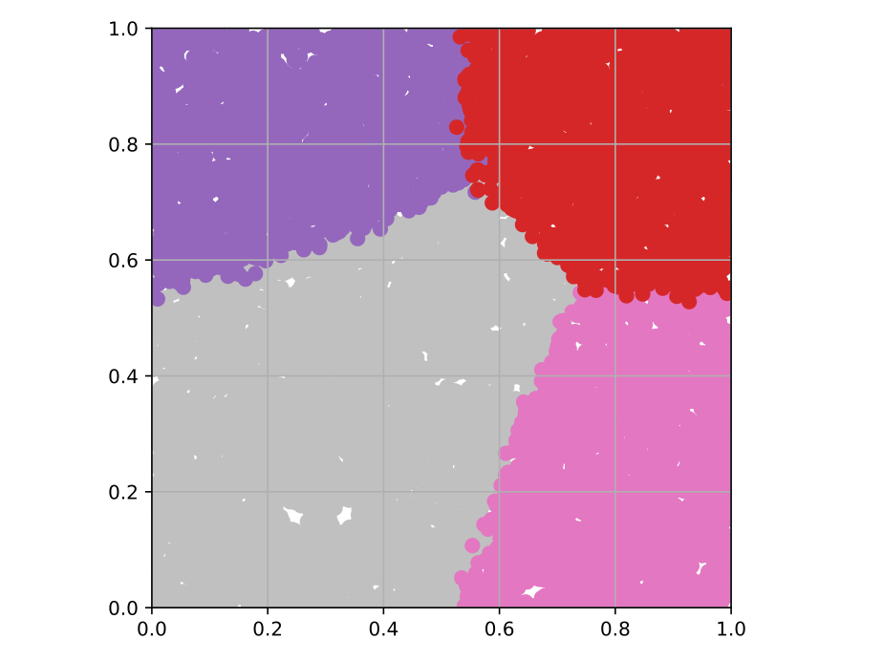

Screen For PURPLE
Screen For BOTH
$ℙ${PURPLE DISEASE}
Do Not Screen
Screen For PINK
$ℙ${PINK DISEASE}

Slide 2

Screen For PINK
Now, the risk of PURPLE is high enough to warrant screening! Screening for PINK and PURPLE benefit each other more as the risk for one increases.
$ℙ${PURPLE DISEASE}
Benefit of screening PINK decreases as the risk of PURPLE increases.
$ℙ${PINK DISEASE}

Slide 3
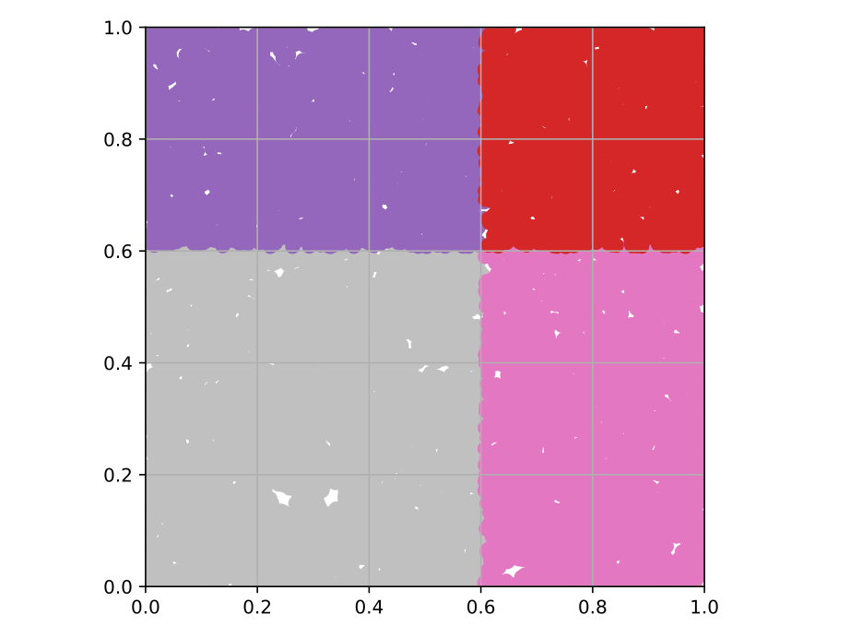


Independent Policies (Each policy has half the budget.)
$ℙ${PURPLE DISEASE}
$ℙ${PURPLE DISEASE}
$ℙ${PINK DISEASE}
$ℙ${PINK DISEASE}

Slide 4
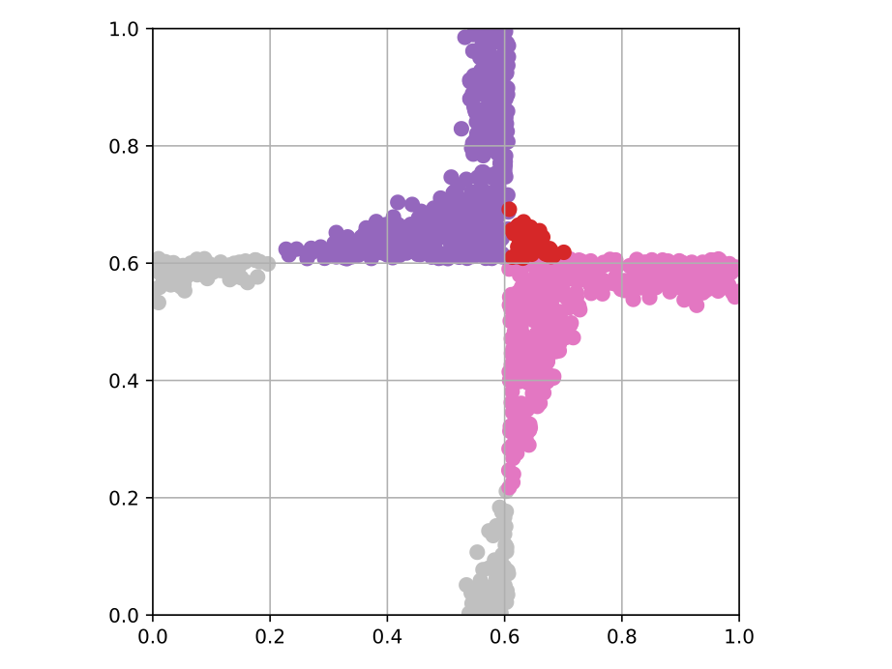
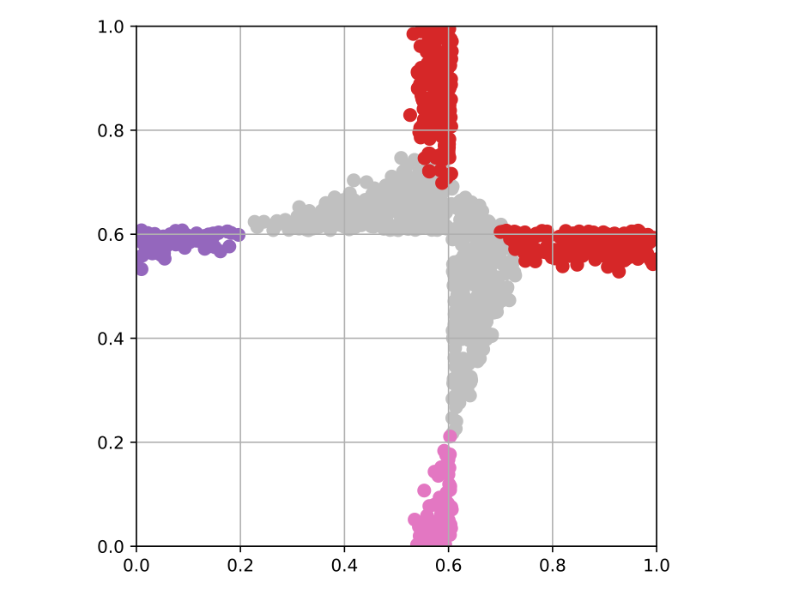
B
A
$ℙ${PURPLE DISEASE}
$ℙ${PURPLE DISEASE}
C
$ℙ${PINK DISEASE}
$ℙ${PINK DISEASE}
+ 0.187 quality-life-years / dollar
+ 0.192 quality-life-years / dollar

Slide 5
Assuming PURPLE is not screened
$ℙ${PURPLE DISEASE}
$ℙ${PINK DISEASE}

Slide 6
Assuming JOINT screening only
$ℙ${PURPLE DISEASE}
$ℙ${PINK DISEASE}

Slide 7
Assuming PURPLE is screened
$ℙ${PURPLE DISEASE}
$ℙ${PINK DISEASE}

Slide 8
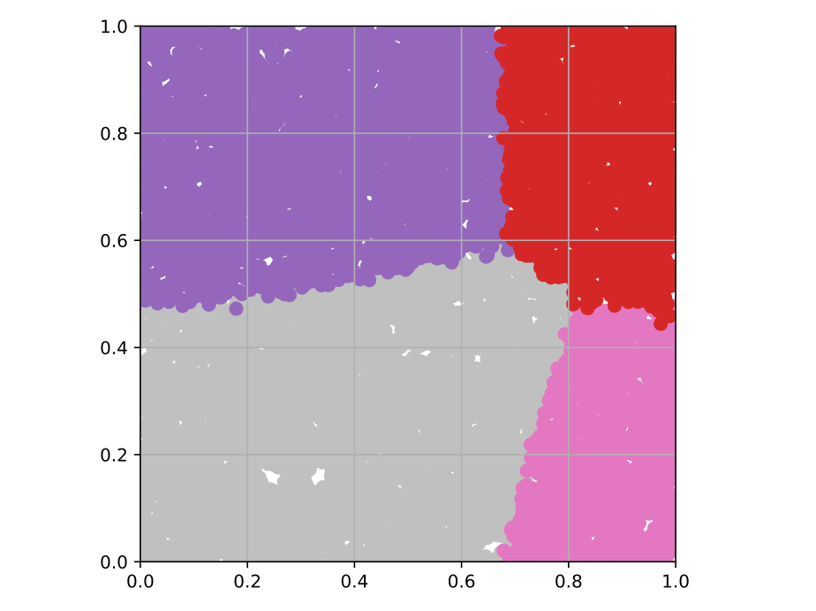


What if PURPLE occurs earlier:
$ℙ${PURPLE DISEASE}
$ℙ${PURPLE DISEASE}
$ℙ${PINK DISEASE}
$ℙ${PINK DISEASE}

